Slide 1


SRINIVASAN COLLEGE OF ARTS AND SCIENCE
PERAMBALUR - 621212
DEPARTMENT OF COMPUTER APPLICATIONS
“WEB BASE ADVANCED METRO RESERVATION
SYSTEM”
FINAL REVIEW
PRESENTED BY:
CHANDRU S 21280425
II - MCA
Project Guide:
Prof.M.RAJAKUMAR
MCA,M.phil,M.Tech,(Ph.D)
Head / Department of computer applications

Slide 2
ABSTRACT
As technology develops, new tools and software are created to make man’s task easier.
It takes a lot of time to wait in line for metro train tickets.
In this metro ticket booking system automation would be helpful for the government to implement proper and better rates for tickets and also for the people as they wouldn’t need to wait in long lines.
By using this technique, travelers can purchase their tickets without having to wait in lengthy lines.
In this project the admin can login the system using his/her user name and password. After the login process the admin can add and update the train details.
It has a specific ticket booking method which has bending and approved method of ticket booking which helps to control the passenger limits on the train.

Slide 3
INTRODUCTION
In this Metro Reservation System Project in PHP focuses mainly on managing online train tickets.
It helps to keep track of all online ticket bookings and information
It allows adding up train, and ticket details too.
Evidently, this project contains an admin panel with an employee and passenger panel.
In an overview of this web application, passengers can simply register themselves and log into the system in order to book online tickets.
He/she can view a list of available trains with their routes, fares, and others respectively.
More over it has so many features comparing to the existing system.

Slide 4
AIM STATEMENT
Information about the route, cancellation of tickets, departure time, arrival time, no.of trains available and other such information.
Store and retrieve information about the various transactions related to rail tickets.
Keep track of all its passengers and the schedule their journey accordingly.
Maintains record of passengers travelling in the different trains on different dates reaching different destinations in the system.
User friendly interface to administrator and customer.
Maintains the accounting section to calculate the total number of booking, number of cost, etc.
Apply travel and trip card by using this system throw online.

Slide 5
EXISTING SYSTEM
Lack of security of data which stored the low level of data about the passenger.
We did not have a proper detail about the passenger who booked the train for the emergency enquiry.
A number of passengers arrived at same time and booked the tickets which is going to be make a harmful incident.
In metro system they didn’t have any method to control this thing. But they can control by using the more man power.
If passenger wants metro travel card they must go to the ticket counter.
There is no travel insurance in the existing system.
In existing system we can’t track the live location of the metro train.

Slide 6
PROPOSED SYSTEM
The aim of the proposed system is to develop a system over come all the limitations of the existing systems.
The system provides proper security and reduces the manual work.
It has high amount of proper information about the passengers.
It has bending and approved stages of ticket booking method.
Which is very helpful to control the number of passengers arrived in to the station/train to avoid the rush.
The passenger can track the live location of the metro train by using the track button.
It has online method of applying metro travel and trip card.
The passenger can get personalized travel card by providing the needed information while applying through online by using this system.
Also it has travel insurance applying process through the online by using this proposed system.

Slide 7
SOFTWARE REQUIREMENTS
Operating system : Windows 7 /8 / 10
Front end : HTML , CSS , JavaScript
Back end : PHP
Database : MySQL
Framework : Bootstrap Application Server : WampServer

Slide 8
HARDWARE REQUIREMENTS
Processor : Intel i3 (R) Pentium quad core
Speed : 1.6 GHz and Above
Hard Disk : Minimum 64 GB
Memory (RAM) : Minimum 4 GB
Monitor : 15 LED SVGA

Slide 9
MODULES
1. Admin login
2. Employee login
3. Passenger login
Passenger login
New Passenger registration

Slide 10
MODULES DESCRIPTION
1. Admin Login:
An admin has full control over the system.
He/she can manage passengers, trains, accounting, and so on.
Here, each and every section has its own respective details such as name, and other important details.
An admin can add passenger records directly by filling up the required forms.
An admin can also add employee members in this system.
Admin can manage the password reset requests.
More over the admin can manage travel and trip card which is applied by the passenger.
Also the admin can manage the travel insurance policy.

Slide 11
2. Employee Login:
Talking about the employee panel, there’s a bit of a similar access level for the employees in this system.
An employee can also manage train details, passengers, and tickets.
In ticket section it has the same access as the administrator where they can manage pending train tickets.
The employees can also view a list of passenger reservations with detailed information.
In addition to it, the accounting section also highlights the overall reservation numbers.
More over the employee also can manage the travel and trip card which is applied by the passenger.
Also can manage the travel insurance policy.

Slide 12
3. Passenger login:
Passenger login : talking about the passenger login here the user already have an account to login their profile. In the user login they can view the available trains and the ticket fare of then trains. here, they can book the train and make payment. Also they can print their booked ticket and status of their ticket. They can track the metro train live location. Also they can apply travel card through online and also they can apply travel insurance.
New Passenger registration : talking about the new passenger registration here the user didn't have an existing account to login so they can create an new account to login their profile. also here they can view the available trains and the ticket fare of then trains. here, they can book the train and make payment. Also they can print their booked ticket and status of their ticket. They can track the metro train live location. Also they can apply travel card through online and also they can apply travel insurance.

Slide 13
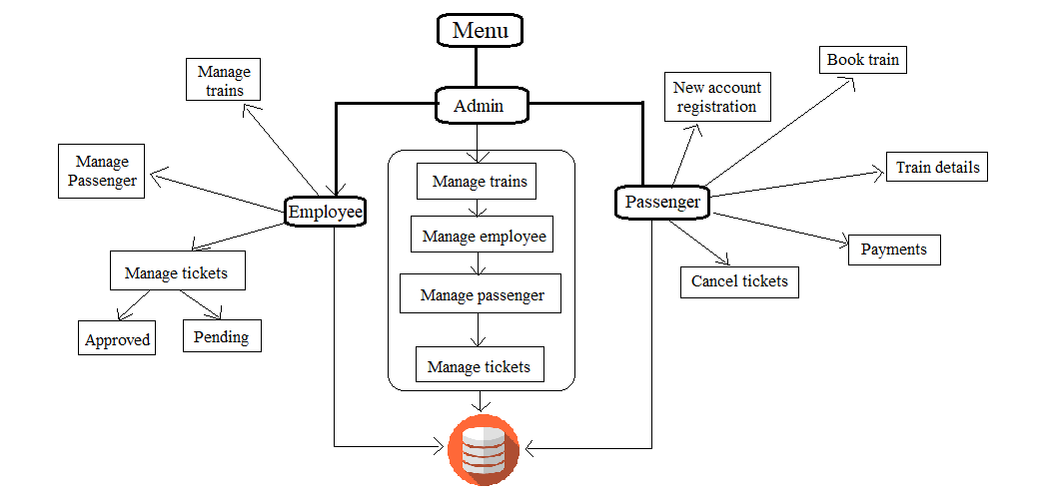
SYSTEM ARCHITECTURE

Slide 14
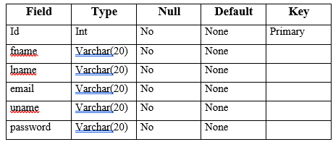
DATABASE DIAGRAM
Admin database

Slide 15
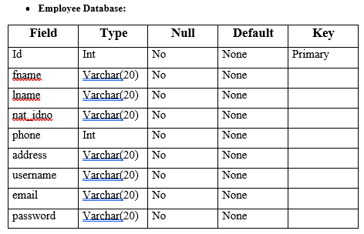
Employee database

Slide 16
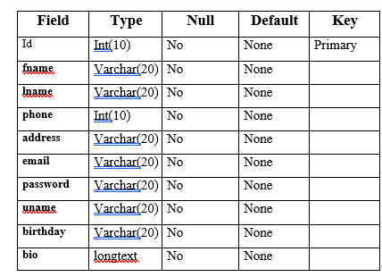
Passenger database

Slide 17
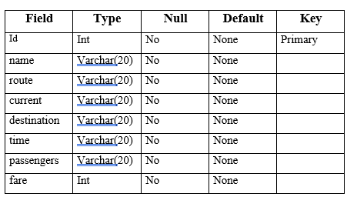
Train database

Slide 18
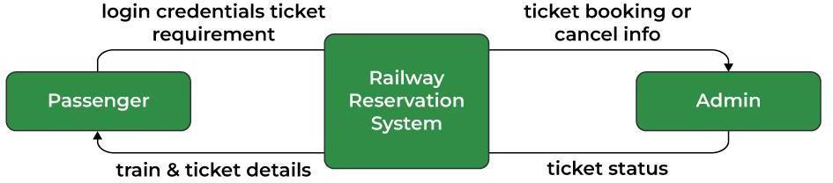
DATA FLOW DIAGRAM
Level 0 Data Flow Diagram for overall system

Slide 19
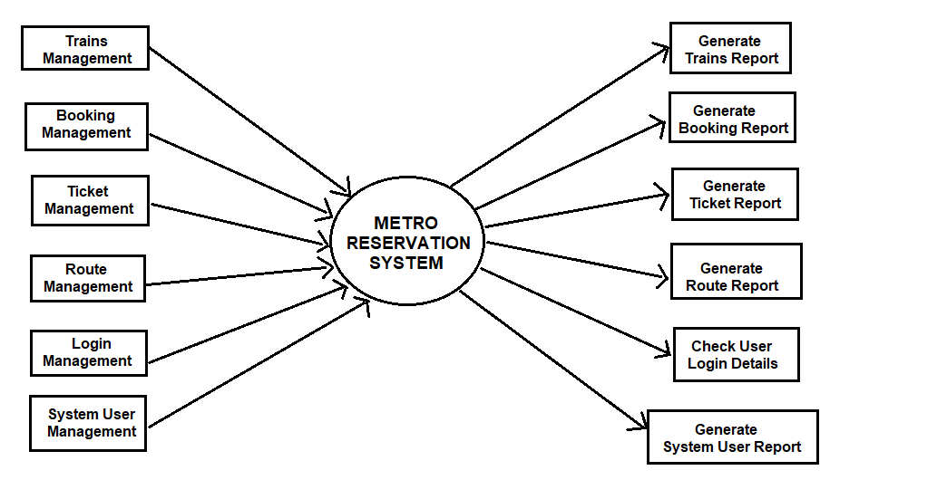
Level 1 Data Flow Diagram for sub-system process

Slide 20
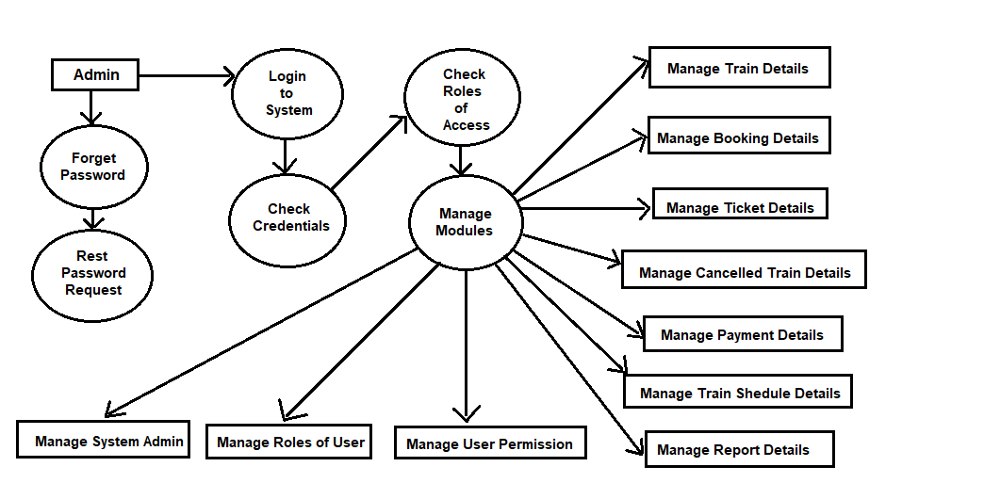
Level 2 Data Flow Diagram for Admin Process

Slide 21
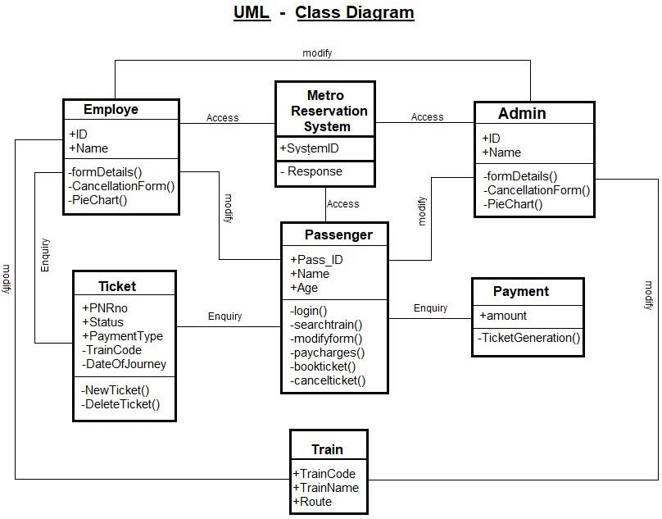
UML DIAGRAM

Slide 22
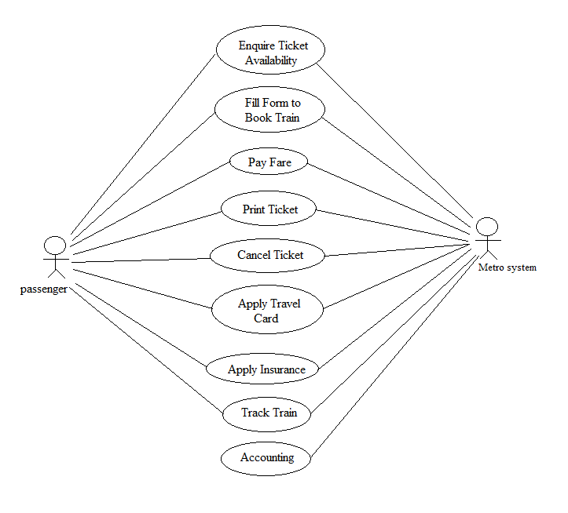
USE - CASE

Slide 23
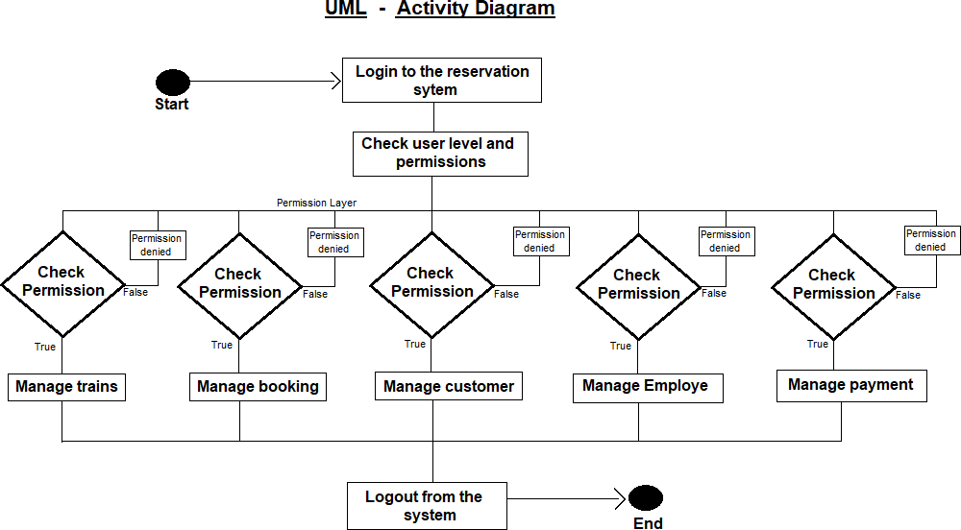

Slide 24
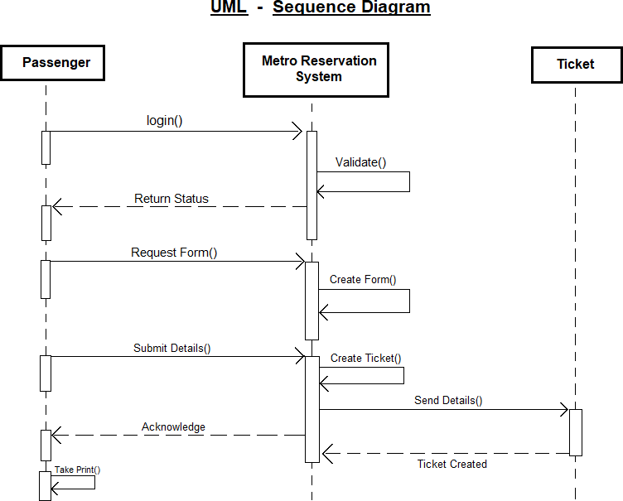

Slide 25
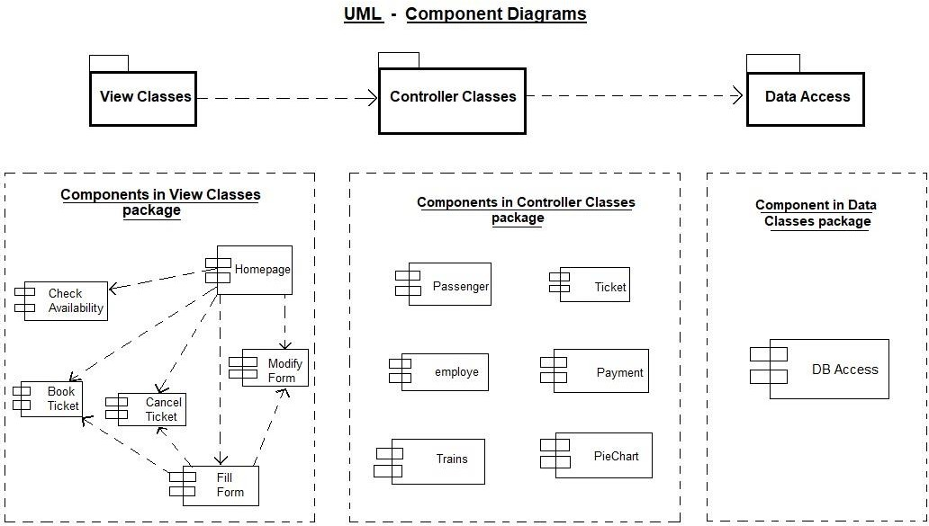

Slide 26
TEST CASES USED
Test case formats may vary from one organization to another. However, using a standard test case format for writing test cases is one step closer to setting up a testing process for your project
Test plan.
Responsive test.
Unit test.
Integration test.
System test.
Acceptance test.

Slide 27
1. TEST PLAN :
● A typical test plan documents input values for the test, procedures used to perform the testing and the expected output values or results.
● Test plans range from very simple to very complex, usually in relation to the complexity of software processes which are to be test.
2.RESPONSIVE TEST :
● Before creating any kind of software applications it must satisfy the users whom used the application in different types of platform like computer or android smartphones.
● The screen size is different in these two devices. The responsive test is used to display the application contents perfectly.
3. UNIT TEST :
● A unit test typically focuses on a minimal component, module or narrow activity.
● The unit test validates that the specific module functions correctly.

Slide 28
4. INTEGRATION TEST :
● Integration testing follows a business process through a series of components, modules and activities.
● To ensure that a function performed by the system works as designed from end to end.
5. SYSTEM TEST :
● System testing takes, as its input, all of the "integrated" components that have successfully passed integration testing.
● System testing is a more limited type of testing, it seeks to detect defects both within the "inter-assemblages" and also within the system as a whole.
6. ACCEPTANCE TEST:
● Acceptance testing usually occurs in cases which require a 'sign-off in order for the coding or functionality to be considered complete.
● If the acceptance testing proves successful, the code or functionality is considered ready for production, and no further changes are required or allowed.

Slide 29
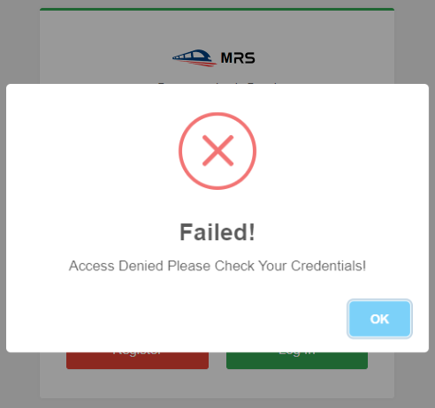
TEST RESULTS:
Login Credentials Test Diagram

Slide 30
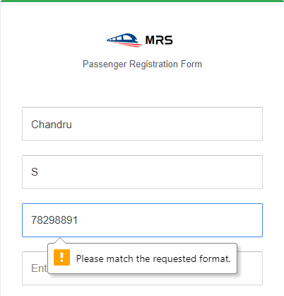
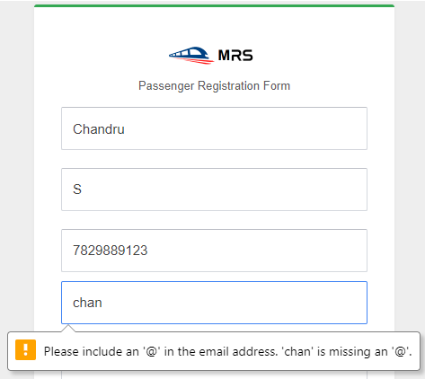
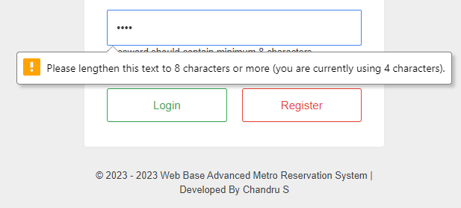
Mobile Number Input Field Required Test
Email Input Field Required Test
Password Input Field Required Test

Slide 31
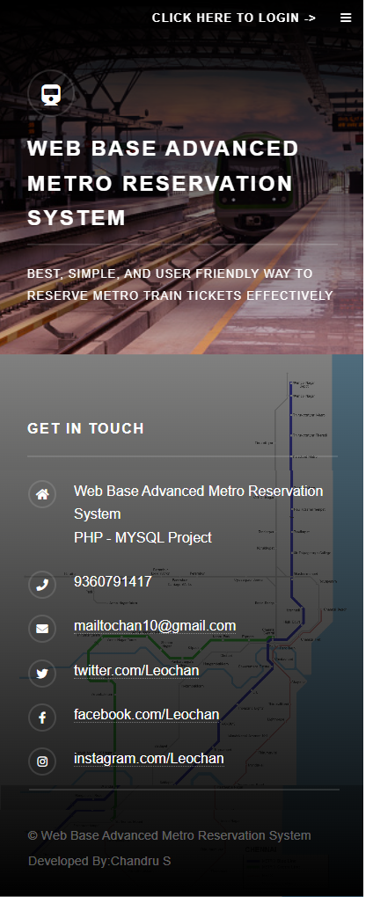
Responsive Test

Slide 32
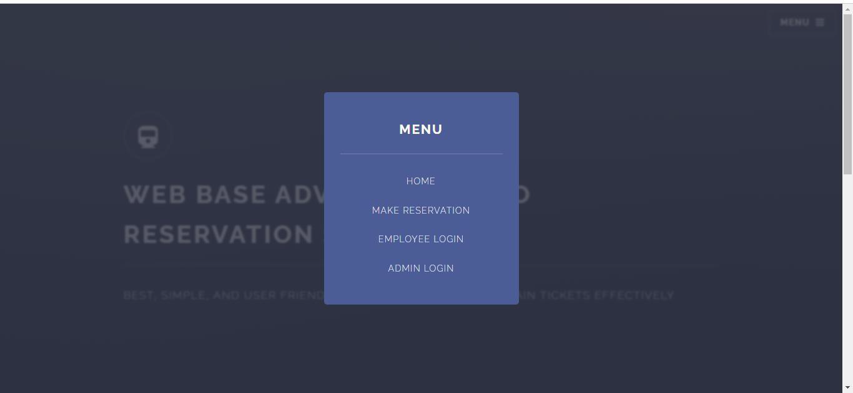
SCREENSHOTS
Home Page login modules

Slide 33
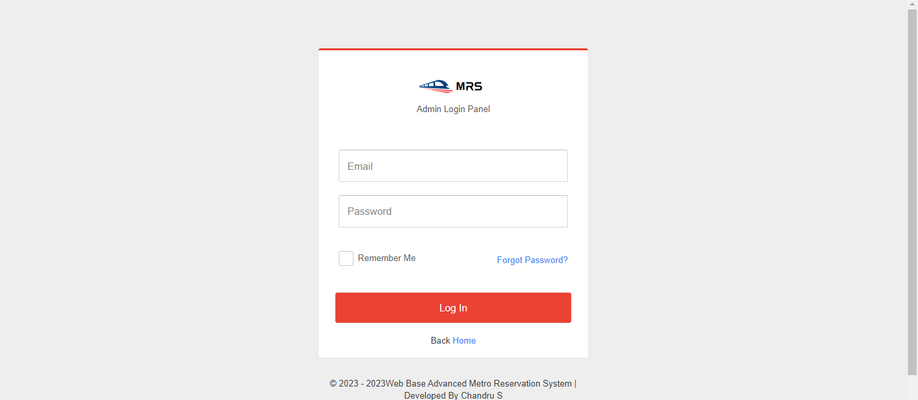
Admin login panel

Slide 34
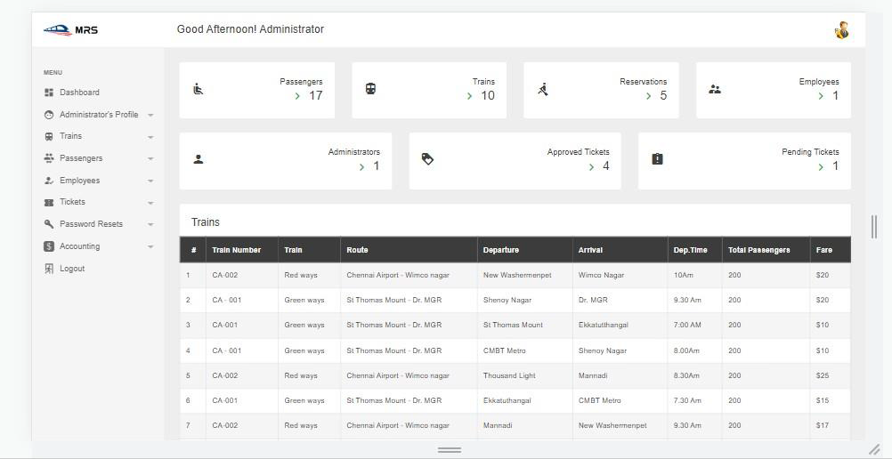
Admin Dashboard

Slide 35
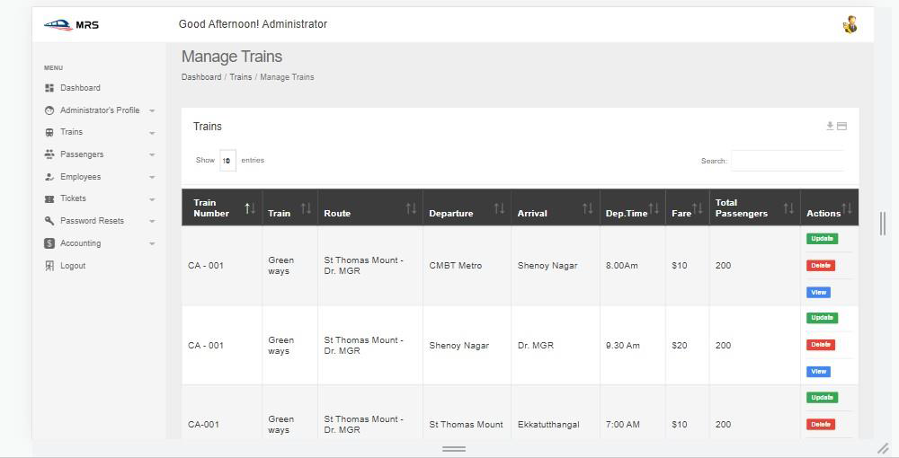
Admin manage trains

Slide 36
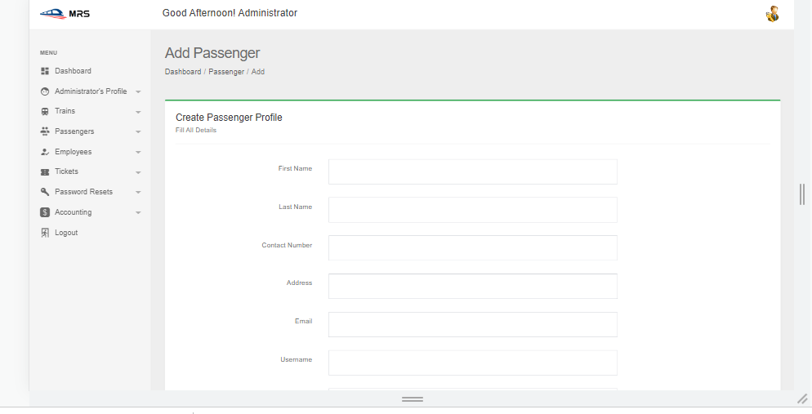
Admin add passenger

Slide 37
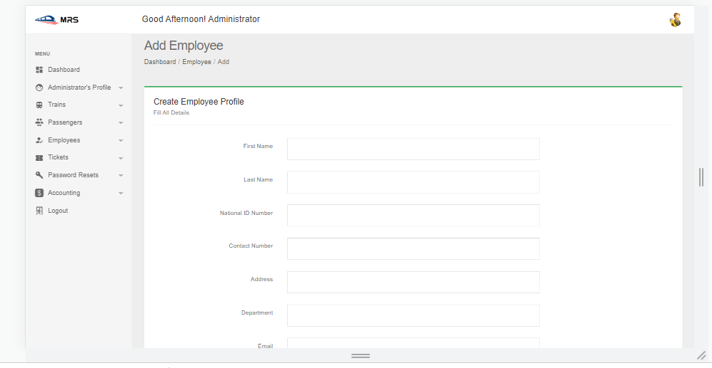
Admin add employee

Slide 38
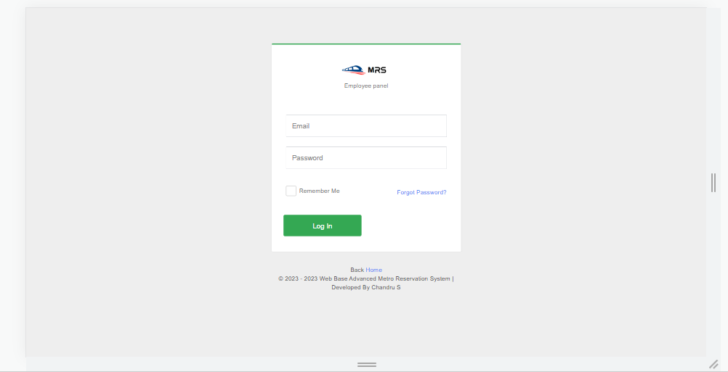
Employee login panel

Slide 39
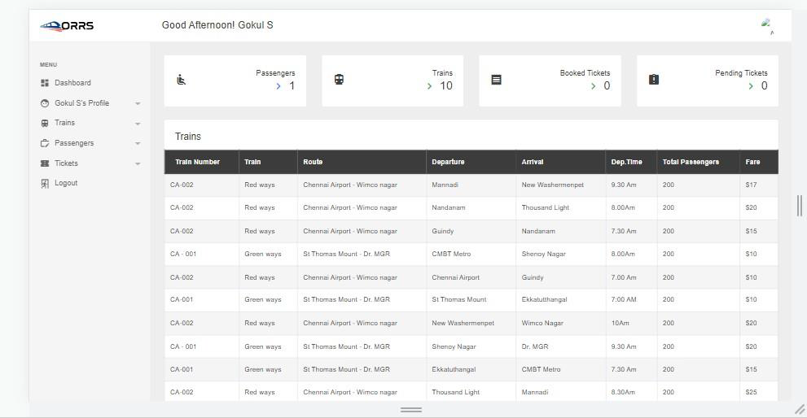
Employee Dashboard

Slide 40
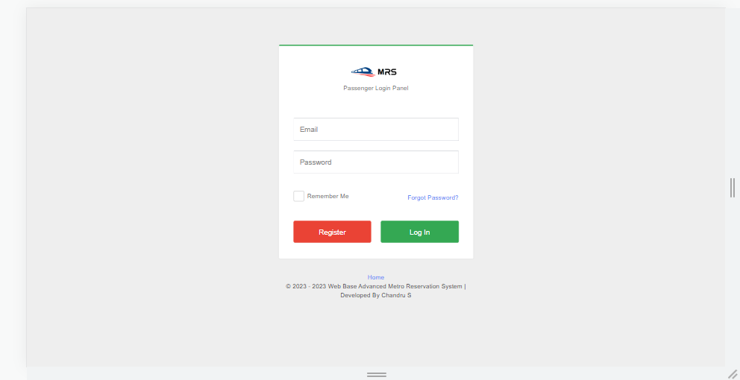
Passenger login form

Slide 41
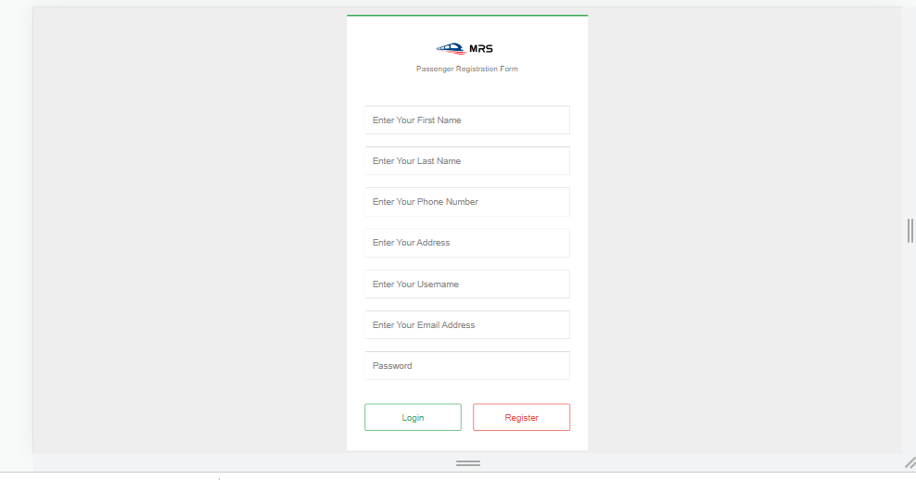
New passenger registration form

Slide 42
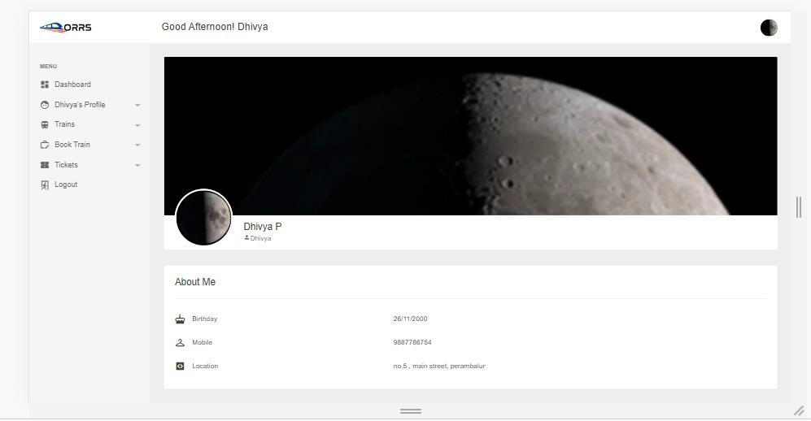
Passenger profile

Slide 43
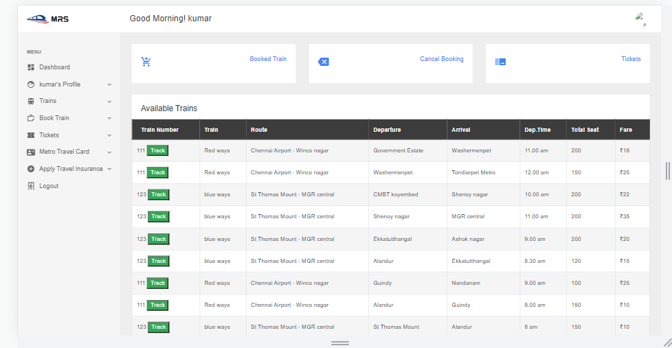
Passenger Dashboard

Slide 44
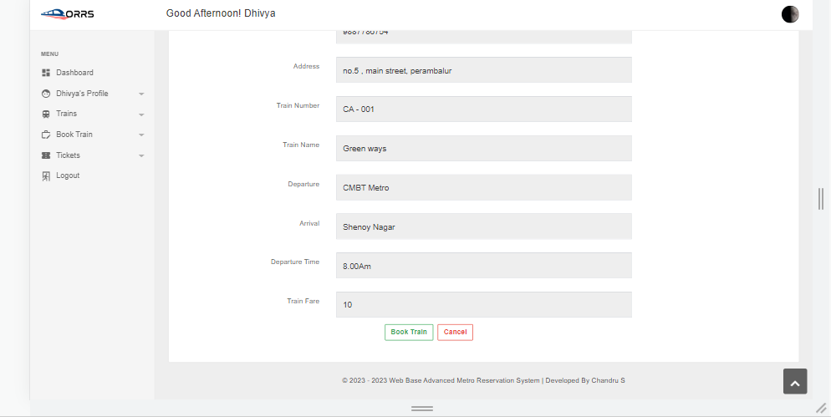
Passenger book train

Slide 45
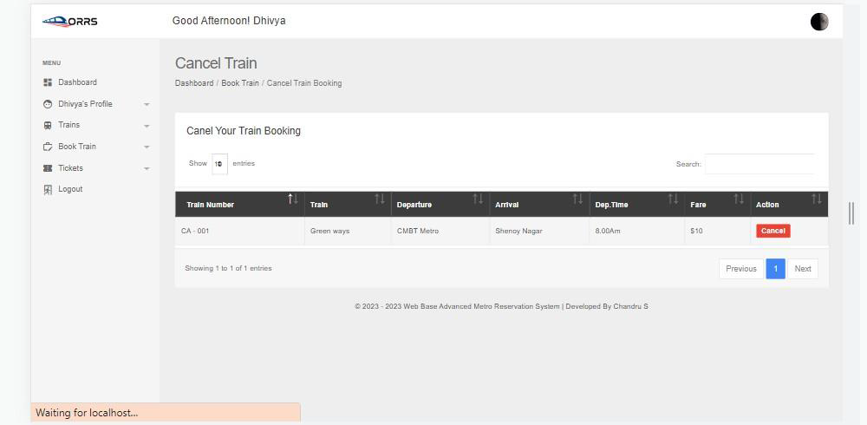
Passenger ticket cancellation

Slide 46
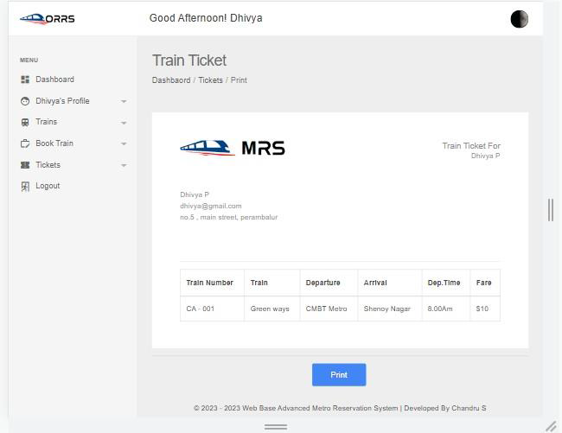
Passenger Booked Ticket Print

Slide 47
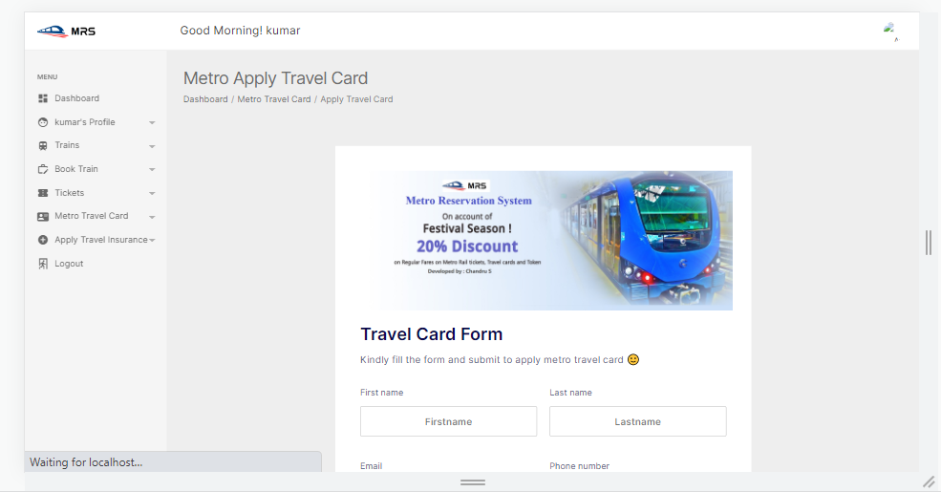
Passenger apply travel card

Slide 48
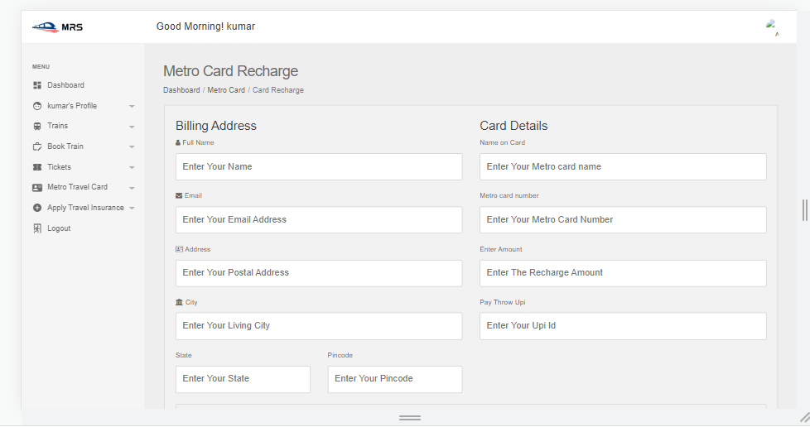
Passenger recharge metro card

Slide 49
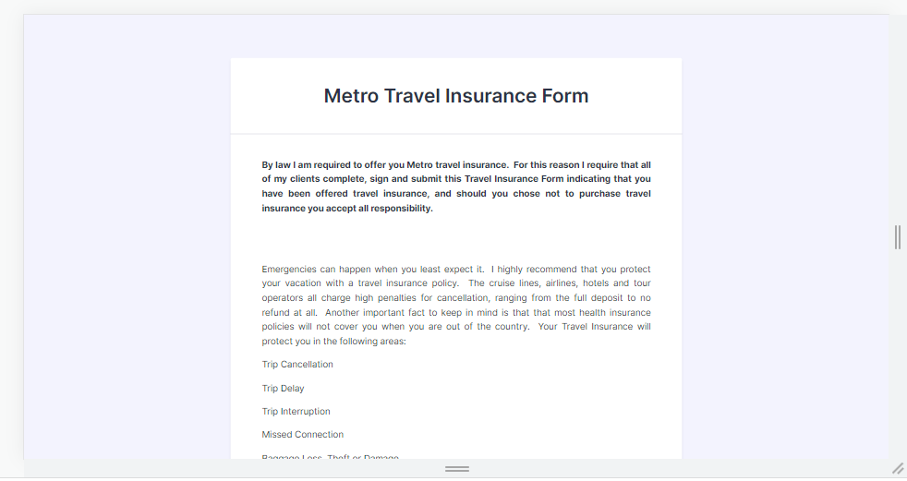
Passenger apply travel insurance

Slide 50
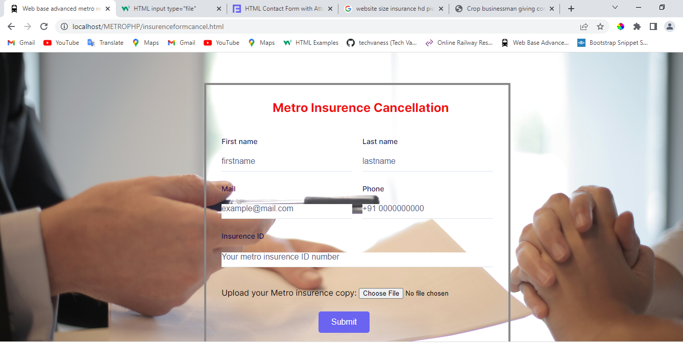
Passenger cancel insurance

Slide 51
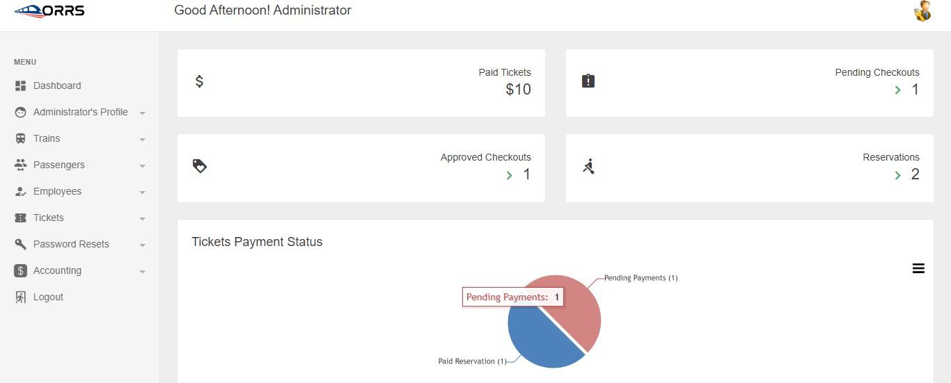
Admin Ticket Summary

Slide 52
CONCLUSION
In this project is designed to help to book the metro ticket easily and the extensive information is available at your fingertips through this system.
Viewing metro train availability, train time, passengers details, employee details, payment controls and related issues are made simple and easy.
There are custom search capabilities to aid in finding train information and working on that records.
This can make the system easier to navigate and to use maximizing the effectiveness of time and other resources.
This system allows the keeping of personal data in a form that can be easily accessed and analyzed in a consistent way.
FUTURE WORK :
It is more efficient and convenient for the metro train ticket booking.
It reduces the man power needed to perform different tasks by reducing the paper works needs.
If all the works are done by computer there will be no chance of errors.
Moreover storing and retrieving of the information is easy, so work can be done speedily and in time.

Slide 53
REFERENCE
Agrawal, R. Imieliński, T. & Swami, A. (1993, June) Mining association rules between sets
of items in large databases. In ACM SIGMOD Record (Vol. 22, No. 2, pp. 207-216) ACM
Bakharia, A. Heathcote, E., & Dawson, S. (2009). Social networks adapting pedagogical practice: SNAPP. Same Places, Different Spaces, ascilite 2009.
Bhullar, M. S., & Kaur, A. (2012, October). Use of Data Mining in Education Sector. In Proceedings of the World Congress on Engineering and Computer Science (Vol. 1, pp. 24-26)
Bienkowski, M., Feng, M., & Means, B. (2012) Enhancing teaching and learning through educational data mining and learning analytics: An issue brief.US Department of Education, Office of Educational Technology, 1-57. Chodorow, K (2013)
MongoDB: the definitive guide. "O'Reilly Media, Inc." Dean, J., & Ghemawat, S. (2008) MapReduce: simplified data processing on large clusters. Communications of the ACM, 51(1), 107-113. Koedinger, K. R., Cunningham, K., Skogsholm, A., & Leber, B. (2008).
An Open Repository and analysis tools for fine-grained, longitudinal learner data EDM, 157, 166, Luján-Mora, S. (2006). A survey of use of weblogs in education. Current developments in technology-assisted education, 1, 260- 264 Marr, B. (Feb 2014).
Use of MapReduce for Data Mining and Data Optimization on a Web Portal UCA, 56(7), 39-43, Nicol, D. J., & MacfarlaneĜDick, D. (2006).
"Pleased Be eAdvised," New York Times Education Life, p 25. Romero, C., & Ventura, S. (2010), Educational data mining: a review of the state of the art Systems, Man, and Cybernetics, Part C: Applications and Reviews, IEEE Transactions on, 40(6), 601-618.
Romero, C., Ventura, S., Pechenizkiy, M., & Baker, R. S. (Eds.). (2011).
Handbook of educational data mining. CRC Press, Russom, P. (2011).

